Slide 1


Data Mining – Bankruptcy Classification Project
Using SAS Enterprise Miner

Slide 2





1
Project Map
Our approach to the bankruptcy classification problem
Classification Problem - Project Workflow
Exploratory Data Analysis (EDA) –
to identify different trends in the raw data
Data Modelling –
running different models to train our data
Way Forward –
major learnings from the project
Data Modification –
preparing our data for modelling
Cross Validation –
public v. private leaderboard score
Project Objective
Apply Classification Algorithms to forecast if a firm will collapse

Slide 3
Data Pre-Processing

Slide 4
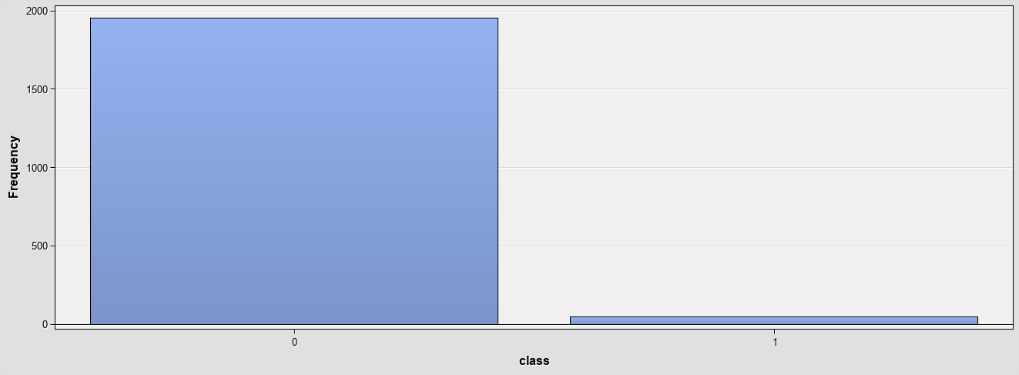
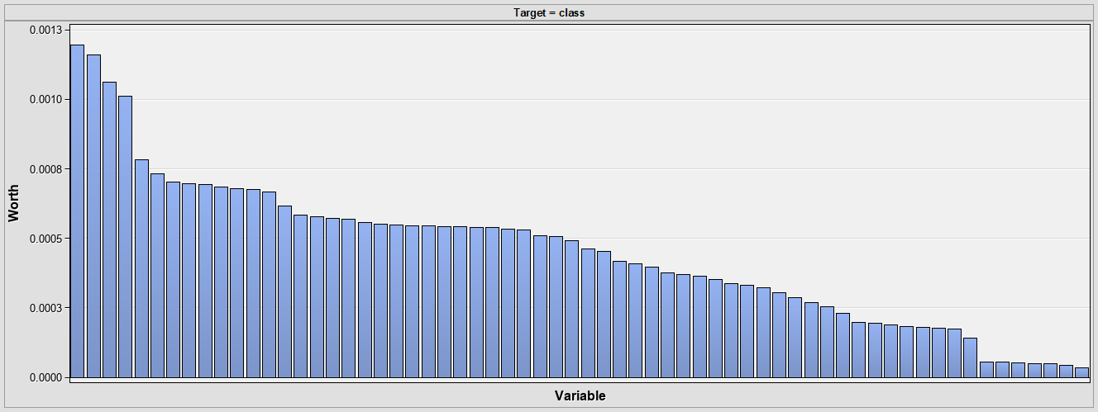
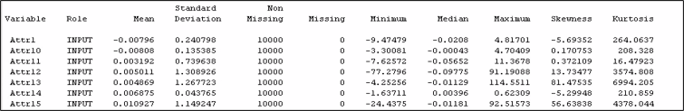
1
Exploratory Data Analysis (EDA)
Identifying patterns in our data
Imbalanced Target Variable – frequency of 0 in the target variable is significantly higher than that of 1, it will be important factor when we model this data later.
Important Attributes – as per the variable worth graph, most important attributes are: attr1, attr10, attr11, attr12 & attr13.

Slide 5
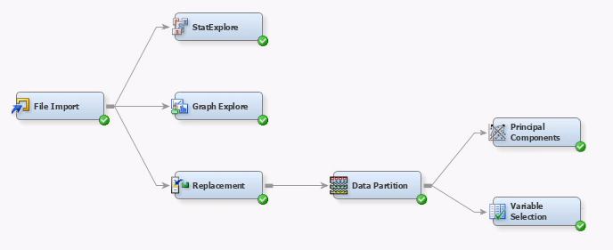
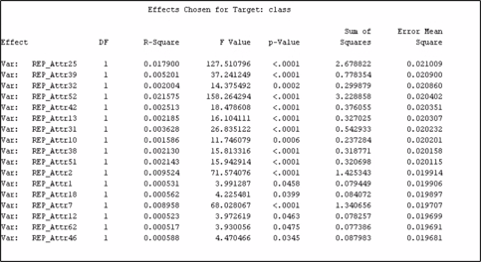
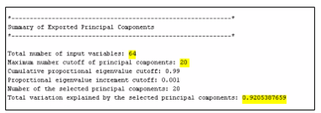
1
Data Modification
Preparing our data for modelling
Variable Selection
Principal Components
Variable selection node returns 17 variables out of the total of 64 that are effective in predicting the target variable, based on their p-values. ​
We set the cutoff for maximum at 20, and for eigenvalues at 0.99. Considering these parameters, 92% of the variation between variables was explained by 20 variables. ​

Slide 6
Data Modelling & Cross Validation

Slide 7
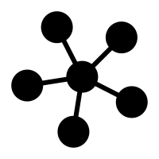
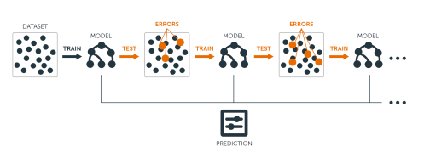
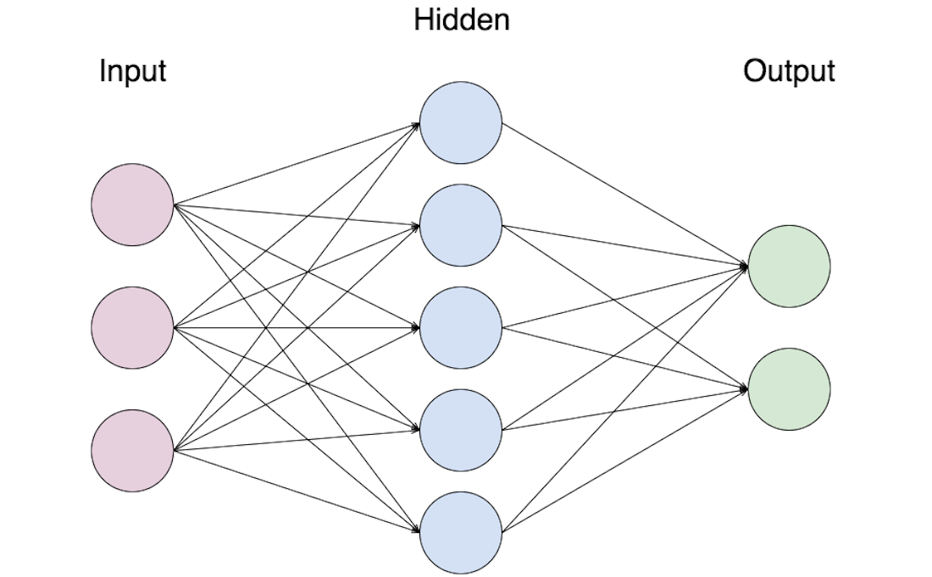
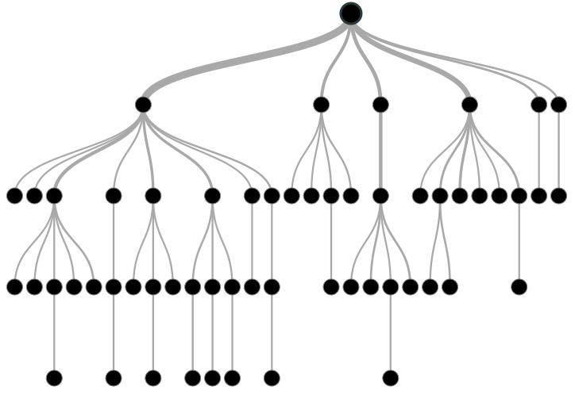
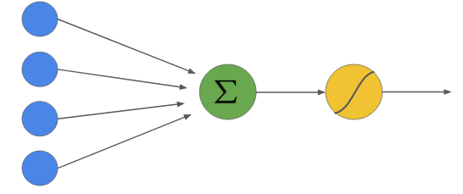
1
Data Modelling
Running different models to fit our data
Total Models Deployed
1
Gradient Boosting
3
Neural Network
Tuning parameters tried: no. of iterations, shrinkage, leaf fraction, max depth & reuse variables.
Tuning parameters tried: number of hidden layers, max iterations, max time & model selection criterion.
2
HP Forest
4
Logistic Regression
Tuning parameters tried: max number of tress, max depth, split size & min category size.
Tuning parameters tried: input coding method. In addition, used transform node before running logistic regression.

Slide 8
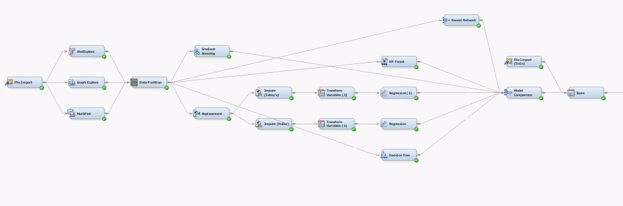
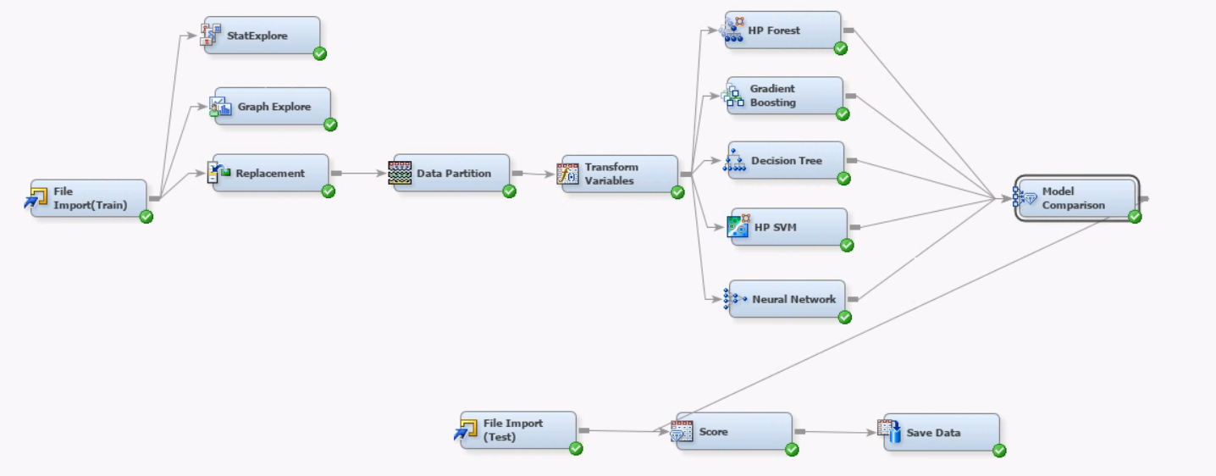
1
Data Modelling
Running different models to fit our data
Best Model #1
Best Model #2
Parameters Used
No. of Iterations: 300
Shrinkage: 0.05
Train Proportion: 80
Max Depth: 6
Re-use Variable: 10
Leaf Fraction: 0.001
Parameters Used
No. of Iterations: 800
Shrinkage: 0.01
Train Proportion: 70
Max Depth: 5
Re-use Variable: 2
Leaf Fraction: 0.001
Valid Score: .92
Public Score: .96
Private Score: .91
Valid Score: .90
Public Score: .92
Private Score: .90

Slide 9
Learnings & Way Forward

Slide 10

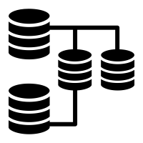

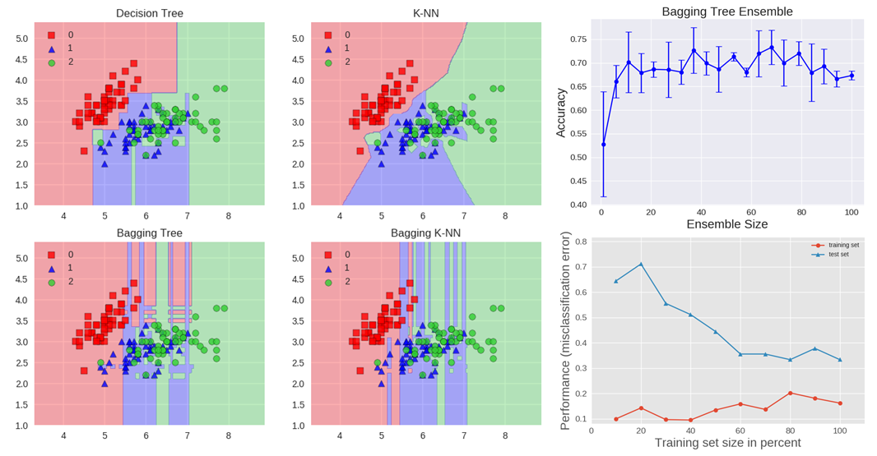

1
Way Forward
Major learnings from public & private leaderboard score difference
1
Shrinkage seems to be a balance parameter as we increase number of iterations. Increasing number of iterations can lead to a better model fit if it is balanced with a decrease in shrinkage.
Gradient Boosting Tuning
2
In addition to number of iterations, max tree depth can be used as a regularization parameter.
3
Better mix of combination and activation functions (Combination = Linear, Activation= mlogistic) for target layer in neural network can be used for better fit.
4
Adjusting the number of hidden layers and changing the architecture can also be used as a balancing parameter for better fit.
Neural Network
5
Combining different models together can help reduce variance in our model fit. For classification, voting could have been used as a judging parameter
6
Enables to train diverse models and use a combination of models to stabilize the overall performance and hence increase accuracy.
Model Ensemble
Notes:
The main principle of boosting is to fit a sequence of weak learners− models that are only slightly better than random guessing, such as small decision trees− to weighted versions of the data. More weight is given to examples that were misclassified by earlier rounds.
The predictions are then combined through a weighted majority vote (classification) or a weighted sum (regression) to produce the final prediction. The principal difference between boosting and the committee methods, such as bagging, is that base learners are trained in sequence on a weighted version of the data.
Classification, regularization – definition (in case of QA)

Slide 11
Thank You!

